Slide 1
Expand the following
4x(2x + 2) = 3(2d – 3) =
x(3d² + 3x) =
Factorise the following
4x + 8 = 6f² – 3f =
9f²g³ + 3f³g² =

Slide 2
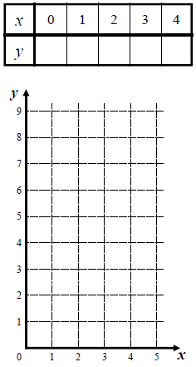


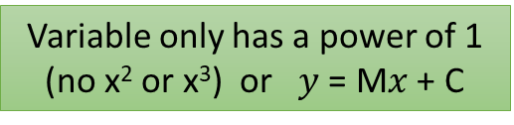
Examples of linear equations
Variable only has a power of 1 (no x² or x³) or $y$ = M$x$ + C
$$y=x+3$$
$y=2x+$1
Changes by a constant amount.
3 4 6 7 8
1 3 5 7 9
Makes a straight line when graphed.

Slide 3


Examples of linear equations
Variable only has a power of 1 (no x² or x³) or $y$ = M$x$ + C
$y=−3x+$8
$y=0.5x−$1
Changes by a constant amount.
8 5 2 -1 -4
-1 -0.5 0 0.5 1
Makes a straight line when graphed.

Slide 4
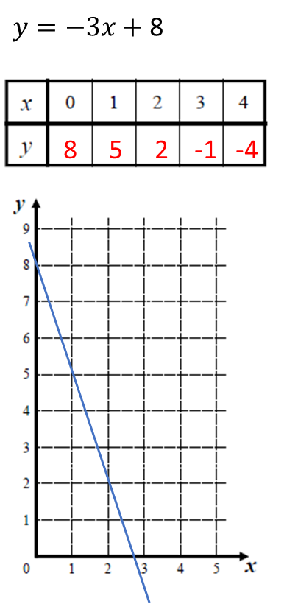
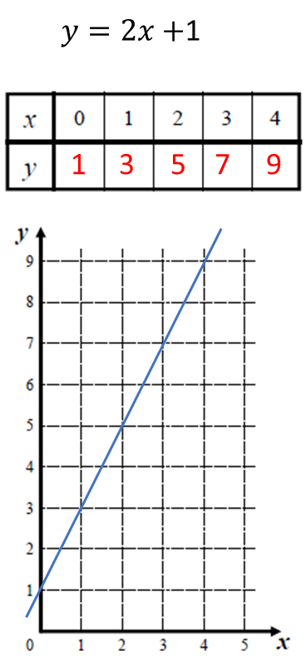
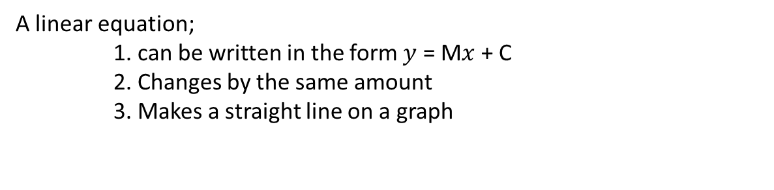
EQ: Linear relationship
EQ: What is a linear relationship?
M is the Gradient
A linear equation;
1. can be written in the form $y$ = M$x$ + C
2. Changes by the same amount
3. Makes a straight line on a graph
C is the y-intercept
The gradient is how much it changes by each time
-3 -3 -3 -3
2 2 2 2
Gradient = -3
Gradient = 2
2
y-intercept = 8
The y-intercept, is the value when you start (x=0)
y-intercept = 1
-3
2
-3
2
2
-3

Slide 5



Let’s try
$$y=2x−1$$
$$y= ____ x ______$$
$$y= ____ x ______$$
4 3 2 1 0

